Slide 1
ENEL 419 PROBABILITY AND RANDOM VARIABLES
4. Discrete Random Variables and Probability Distributions
(Reading Exercises: Montgomery and Runger Section 2.9, 3.1-3.2, 3.4-3.8 & Class notes)
(Reading Exercises: Yates and Goodman Chapter 3)

Slide 2
Major Pioneers of Probability and Statistics

Slide 3
Major Pioneers of Probability and Statistics

Slide 4
Major Pioneers of Probability and Statistics

Slide 5
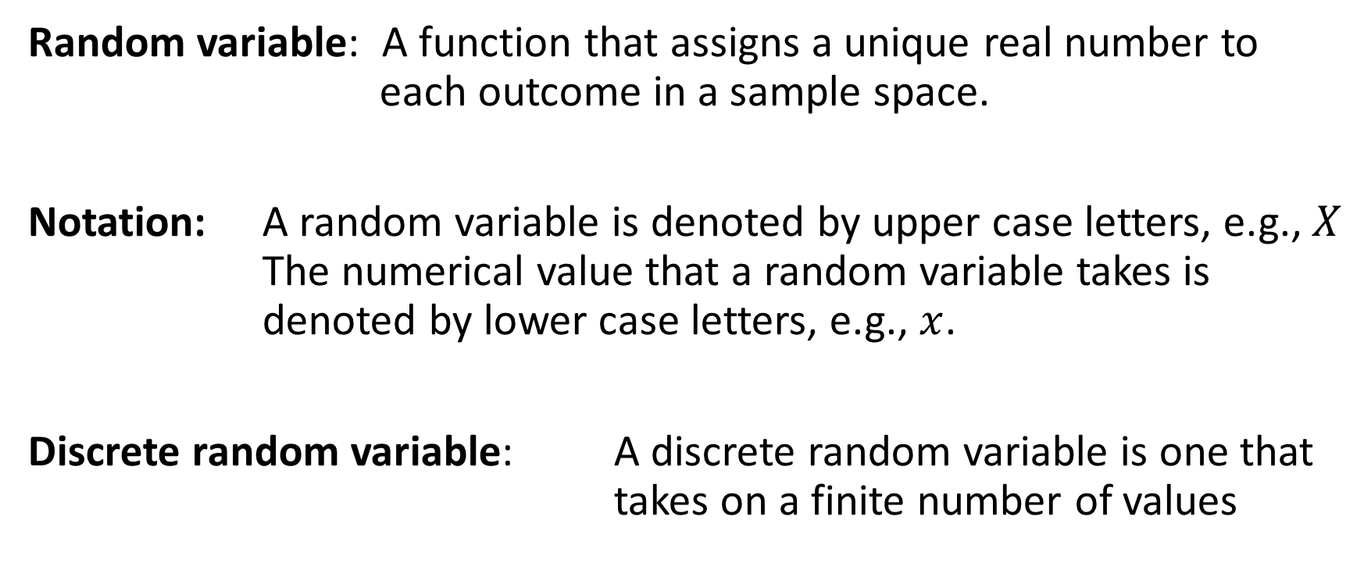
Basic Definitions
Random variable: A function that assigns a unique real number to each outcome in a sample space.
Notation: A random variable is denoted by upper case letters, e.g.,$X$ The numerical value that a random variable takes is denoted by lower case letters, e.g., $x$.
Discrete random variable: A discrete random variable is one that takes on a finite number of values

Slide 6
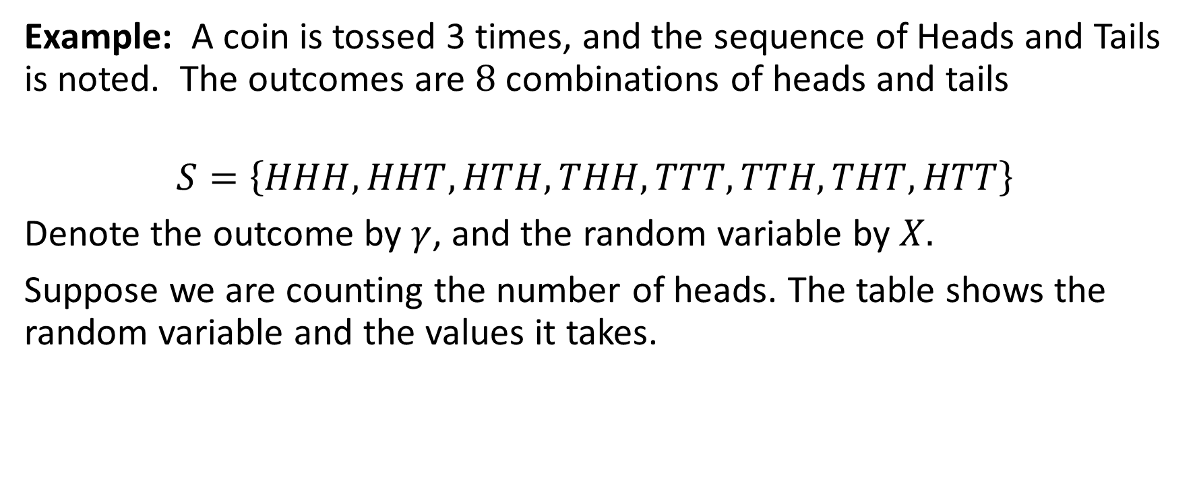
Discrete Random Variables
Example: A coin is tossed 3 times, and the sequence of Heads and Tails is noted. The outcomes are $8$combinations of heads and tails
$$S=\left\{HHH, HHT, HTH, THH, TTT, TTH, THT, HTT\right\}$$
Denote the outcome by $γ$, and the random variable by $X.$
Suppose we are counting the number of heads. The table shows the random variable and the values it takes.
$$γ$$ | $$HHH$$ | $$HHT$$ | $$HTH$$ | $$THH$$ | $$TTT$$ | $$TTH$$ | $$THT$$ | $$HTT$$
$$X\left(γ\right)$$ | $$3$$ | $$2$$ | $$2$$ | $$2$$ | $$0$$ | $$1$$ | $$1$$ | $$1$$

Slide 7
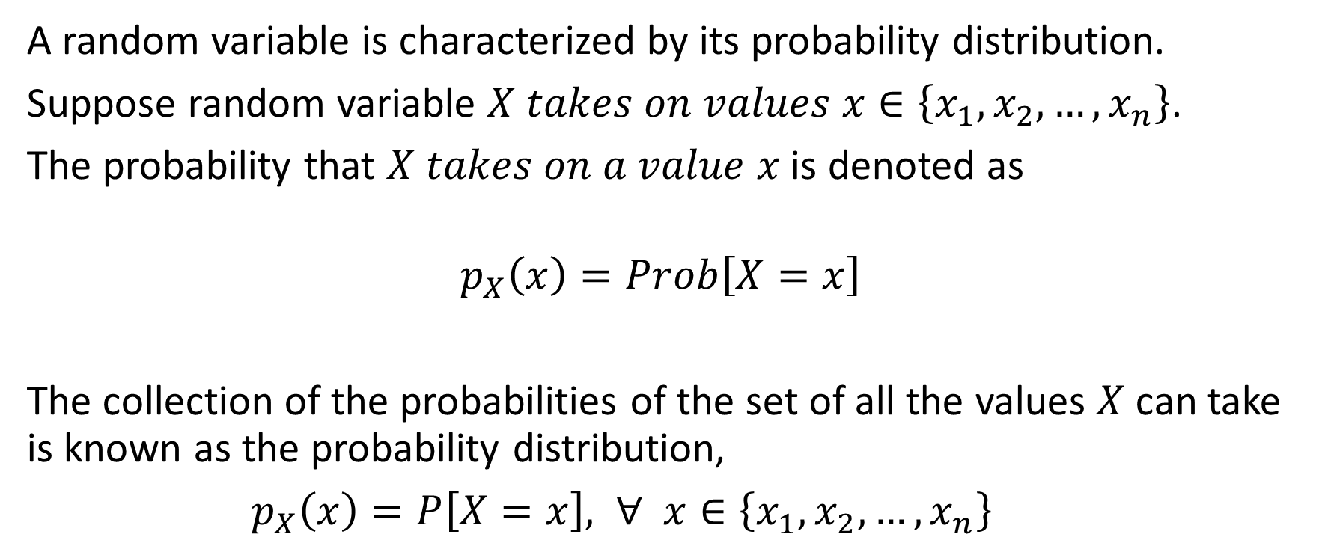
Characterization of Discrete Random Variables
A random variable is characterized by its probability distribution.
Suppose random variable $X takes on values x∈\left\{x_{1}, x_{2},…,x_{n}\right\}$.
The probability that $X takes on a value x$ is denoted as
$$p_{X}\left(x\right)=Prob\left[X=x\right]$$
The collection of the probabilities of the set of all the values $X$ can take is known as the probability distribution,
$p_{X}\left(x\right)=P\left[X=x\right], ∀$ $x∈\left\{x_{1}, x_{2},…,x_{n}\right\}$

Slide 8
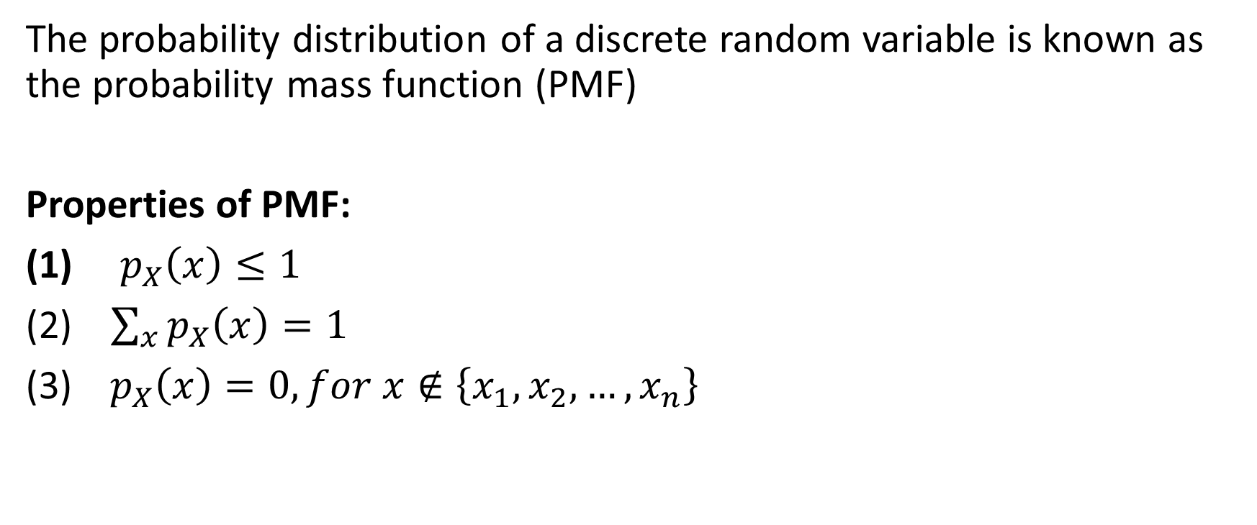
Probability Mass Function
The probability distribution of a discrete random variable is known as the probability mass function (PMF)
Properties of PMF:
(1) ${ p}_{X}\left(x\right)≤1$
(2) $\sum_{x}{p_{X}\left(x\right)=1}$
(3)$p_{X}\left(x\right)=0, for x∉\left\{x_{1}, x_{2},…, x_{n}\right\}$

Slide 9
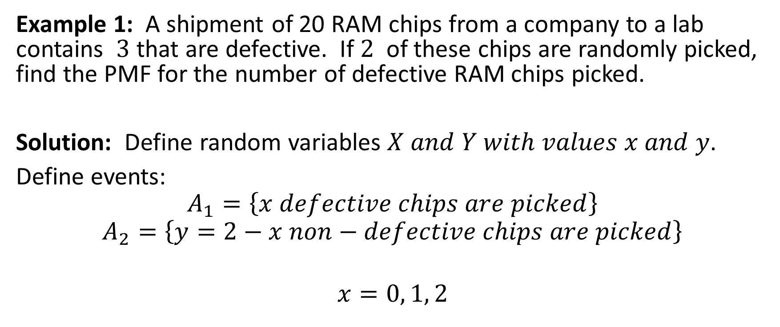
PMF Examples
Example 1: A shipment of 20 RAM chips from a company to a lab contains $3$ that are defective. If $2$ of these chips are randomly picked, find the PMF for the number of defective RAM chips picked.
Solution: Define random variables $X and Y with values x and y$.
Define events:
$$A_{1}=\left\{x defective chips are picked\right\}$$
$$A_{2}=\left\{y=2−x non−defective chips are picked\right\}$$
$$x=0, 1, 2$$

Slide 10
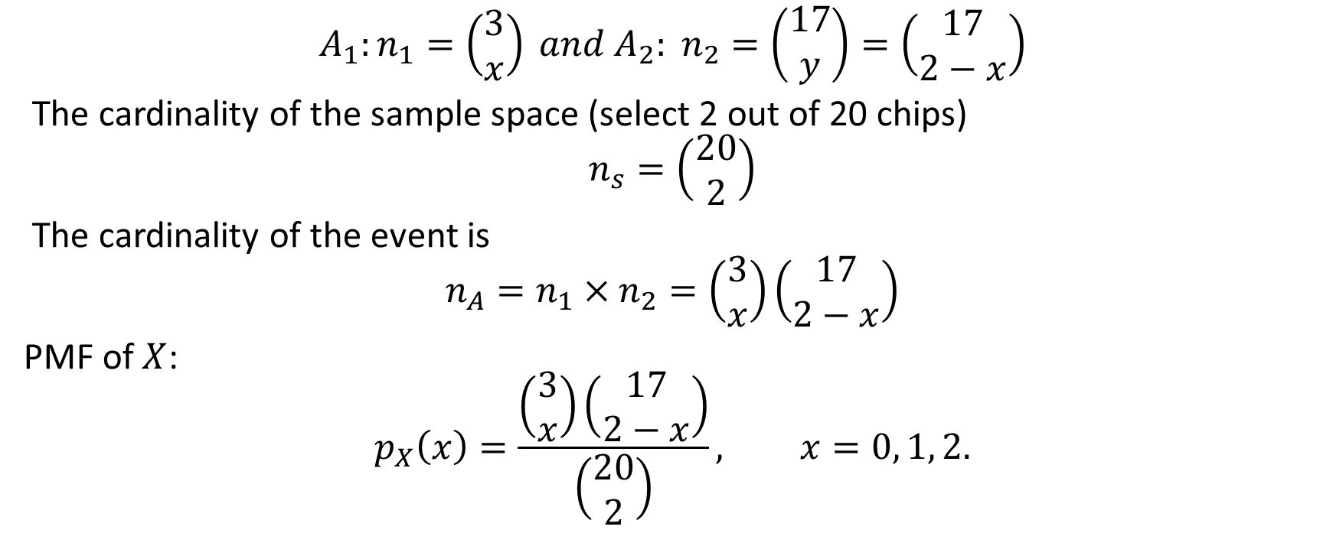
PMF Example 1 continued
$$A_{1}:n_{1}=\left(\begin{aligned}3 \\ x\end{aligned}\right) and A_{2}: n_{2}=\left(\begin{aligned}17 \\ y\end{aligned}\right)=\left(\begin{aligned}17 \\ 2−x\end{aligned}\right)$$
The cardinality of the sample space (select 2 out of 20 chips)
$$n_{s}=\left(\begin{aligned}20 \\ 2\end{aligned}\right)$$
The cardinality of the event is
$$n_{A}=n_{1}×n_{2}=\left(\begin{aligned}3 \\ x\end{aligned}\right)\left(\begin{aligned}17 \\ 2−x\end{aligned}\right)$$
PMF of $X$:
$$p_{X}\left(x\right)=\frac{\left(\begin{aligned}3 \\ x\end{aligned}\right)\left(\begin{aligned}17 \\ 2−x\end{aligned}\right)}{\left(\begin{aligned}20 \\ 2\end{aligned}\right)}, x=0, 1, 2.$$

Slide 11

PMF Example 1 continued
PMF:
$$p_{X}\left(0\right)=P\left[X=0\right]=\frac{\left(\begin{aligned}3 \\ 0\end{aligned}\right)\left(\begin{aligned}17 \\ 2\end{aligned}\right)}{\left(\begin{aligned}20 \\ 2\end{aligned}\right)}=\frac{68}{95}=\frac{136}{190}$$
$$p_{X}\left(1\right)=P\left[X=1\right]=\frac{\left(\begin{aligned}3 \\ 1\end{aligned}\right)\left(\begin{aligned}17 \\ 1\end{aligned}\right)}{\left(\begin{aligned}20 \\ 2\end{aligned}\right)}=\frac{3×17}{10×19}=\frac{51}{190}$$
$$p_{X}\left(2\right)=P\left[X=2\right]=\frac{\left(\begin{aligned}3 \\ 2\end{aligned}\right)\left(\begin{aligned}17 \\ 0\end{aligned}\right)}{\left(\begin{aligned}20 \\ 2\end{aligned}\right)}=\frac{3}{190}$$

Slide 12
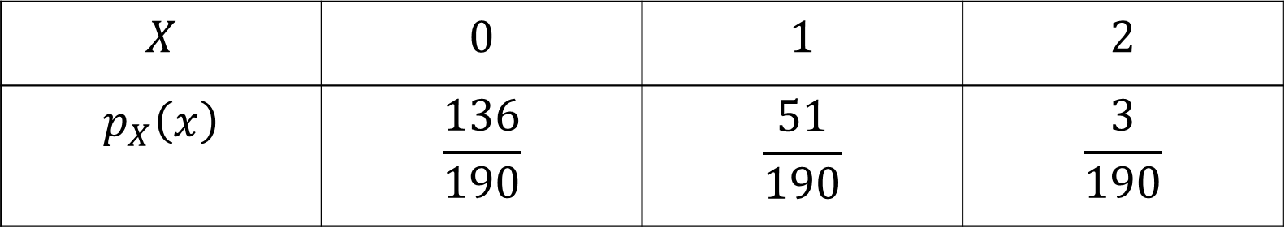

PMF Example 1 continued
$$Check: \sum_{x=0}^{2}{p_{X}\left(x\right)=1 ⇒valid PMF}$$
PMF in tabular form:
$$X$$ | $$0$$ | $$1$$ | $$2$$
$$p_{X}\left(x\right)$$ | $$\frac{136}{190}$$ | $$\frac{51}{190}$$ | $$\frac{3}{190}$$

Slide 13
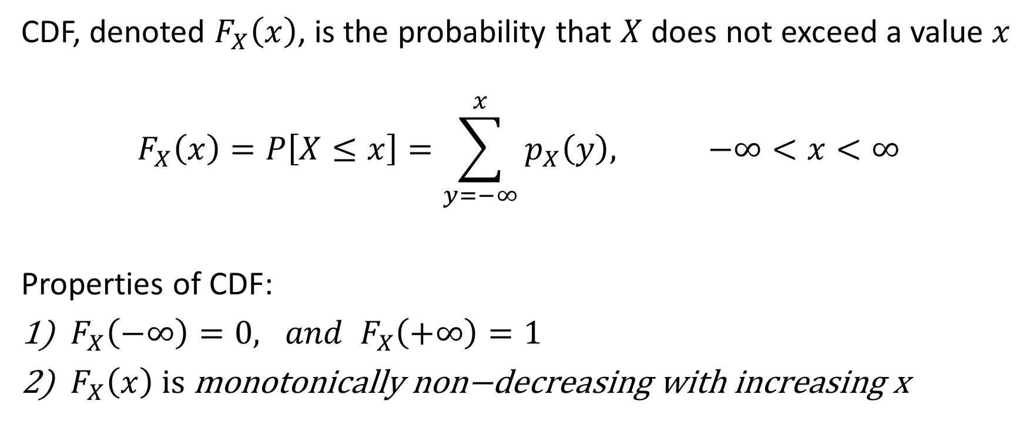
Cumulative Distribution Function (CDF) for Discrete Random Variable
CDF, denoted $F_{X}\left(x\right)$, is the probability that $X$ does not exceed a value $x$
$$F_{X}\left(x\right)=P\left[X≤x\right]=\sum_{y=−∞}^{x}{p_{X}\left(y\right), −∞<x<∞}$$
Properties of CDF:
$F_{X}\left(−∞\right)=0, and F_{X}\left(+∞\right)=1$
$F_{X}\left(x\right) \text{is} \text{monotonically} \text{non}\text{−}\text{decreasing} \text{with} \text{increasing} \text{x}$

Slide 14
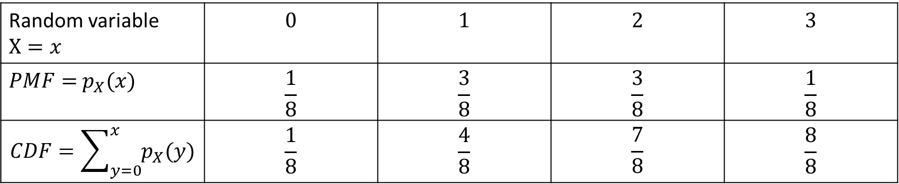

PMF and CDF Examples
Example 2: The table below represents the PMF and the CDF of random variable $X$, representing the number of heads in $3$ tosses of a fair coin. There are $8$ possible outcomes when a coin is tossed $3$ times.
$$S=\left\{HHH, HHT, HTH, THH, TTT, TTH, THT, HTT\right\}$$
Tabular representation:
Random variable $X=x$ | $$0$$ | $$1$$ | $$2$$ | $$3$$
$PMF=$ $p_{X}(x)$ | $$\frac{1}{8}$$ | $$\frac{3}{8}$$ | $$\frac{3}{8}$$ | $$\frac{1}{8}$$
$$CDF=\sum_{y=0}^{x}{p_{X}(y)}$$ | $$\frac{1}{8}$$ | $$\frac{4}{8}$$ | $$\frac{7}{8}$$ | $$\frac{8}{8}$$

Slide 15
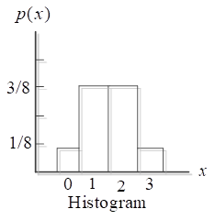
Graphical Representations of PMF and CDF
PMF, CDF and Histogram:

Slide 16
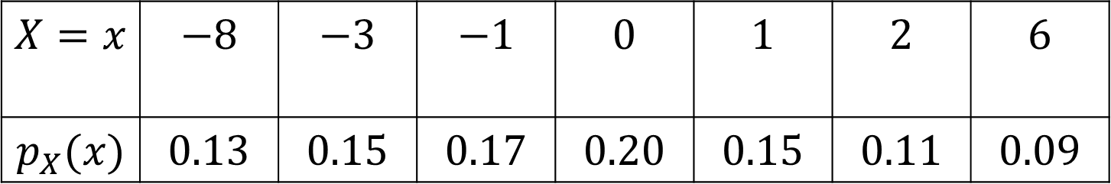
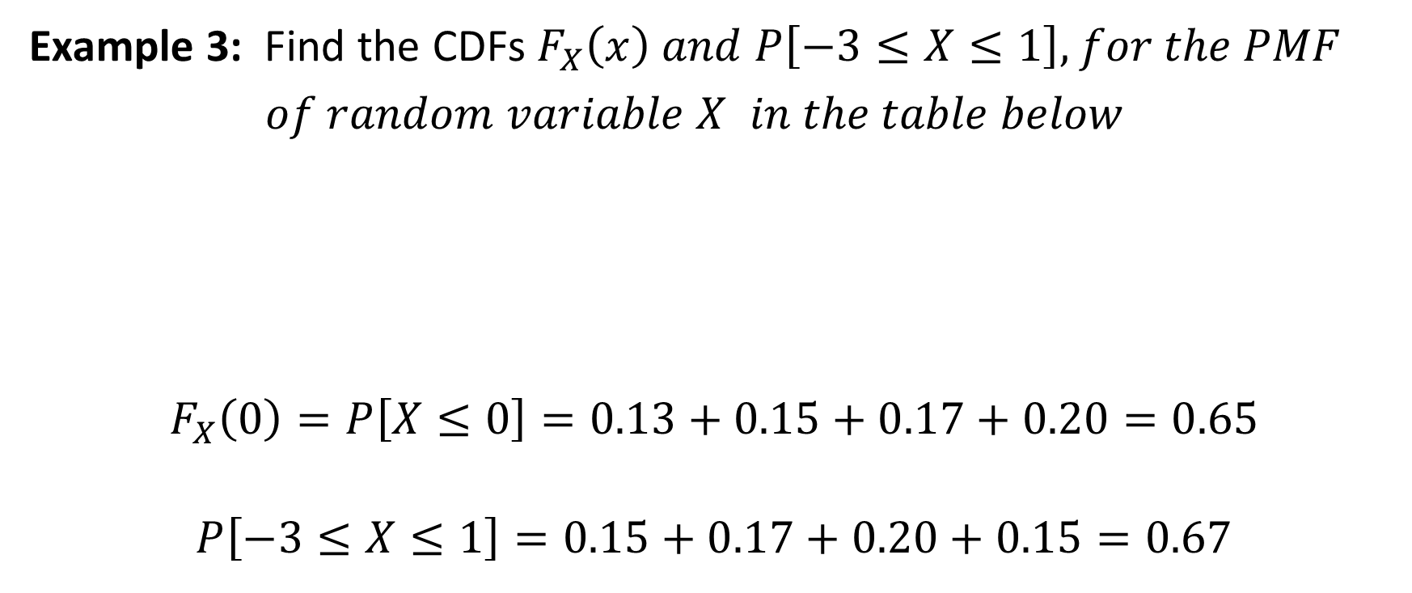
PMF and CDF Examples
Example 3: Find the CDFs $F_{X}\left(x\right) and P\left[−3≤X≤1\right],$ 𝑓𝑜𝑟 𝑡ℎ𝑒 𝑃𝑀𝐹
𝑜𝑓 𝑟𝑎𝑛𝑑𝑜𝑚 𝑣𝑎𝑟𝑖𝑎𝑏𝑙𝑒 $X$ 𝑖𝑛 𝑡ℎ𝑒 𝑡𝑎𝑏𝑙𝑒 𝑏𝑒𝑙𝑜𝑤
$$F_{X}\left(0\right)=P\left[X≤0\right]=0.13+0.15+0.17+0.20=0.65$$
$$P\left[−3≤X≤1\right]=0.15+0.17+0.20+0.15=0.67$$
$$X=x$$ | $$−8$$ | $$−3$$ | $$−1$$ | $$0$$ | $$1$$ | $$2$$ | $$6$$
$$p_{X}(x)$$ | $$0.13$$ | $$0.15$$ | $$0.17$$ | $$0.20$$ | $$0.15$$ | $$0.11$$ | $$0.09$$

Slide 17
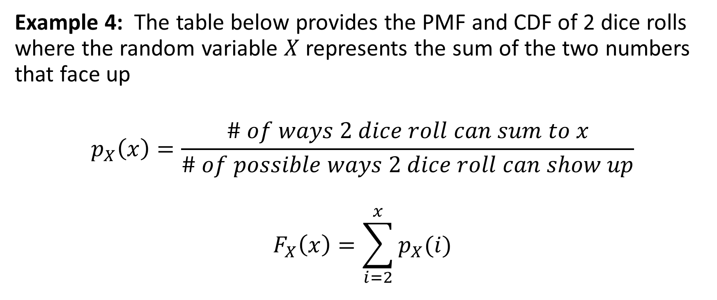
PMF and CDF Examples
Example 4: The table below provides the PMF and CDF of 2 dice rolls where the random variable $X$ represents the sum of the two numbers that face up
$$p_{X}\left(x\right)=\frac{\# of ways 2 dice roll can sum to x}{\# of possible ways 2 dice roll can show up}$$
$$F_{X}\left(x\right)=\sum_{i=2}^{x}{p_{X}(i)}$$

Slide 18
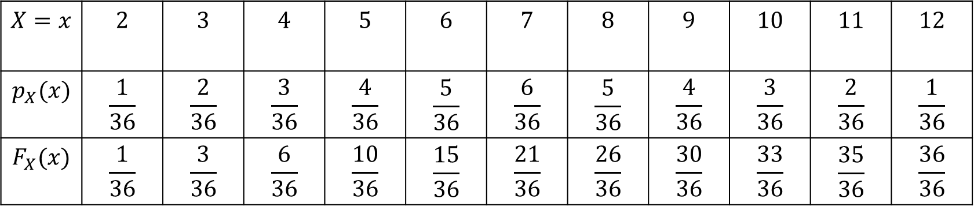
PMF and CDF Example 4 continued
Probability Mass Function & CDF of two dice roll
$$X=x$$ | $$2$$ | $$3$$ | $$4$$ | $$5$$ | $$6$$ | $$7$$ | $$8$$ | $$9$$ | $$10$$ | $$11$$ | $$12$$
$$p_{X}(x)$$ | $$\frac{1}{36}$$ | $$\frac{2}{36}$$ | $$\frac{3}{36}$$ | $$\frac{4}{36}$$ | $$\frac{5}{36}$$ | $$\frac{6}{36}$$ | $$\frac{5}{36}$$ | $$\frac{4}{36}$$ | $$\frac{3}{36}$$ | $$\frac{2}{36}$$ | $$\frac{1}{36}$$
$$F_{X}(x)$$ | $$\frac{1}{36}$$ | $$\frac{3}{36}$$ | $$\frac{6}{36}$$ | $$\frac{10}{36}$$ | $$\frac{15}{36}$$ | $$\frac{21}{36}$$ | $$\frac{26}{36}$$ | $$\frac{30}{36}$$ | $$\frac{33}{36}$$ | $$\frac{35}{36}$$ | $$\frac{36}{36}$$

Slide 19
Important Discrete Random Variables
Counting Processes:
Binomial random variables,
Geometric random variable
Poisson random variables.
Fundamental to counting processes is the Bernoulli trial and Bernoulli random variable.

Slide 20
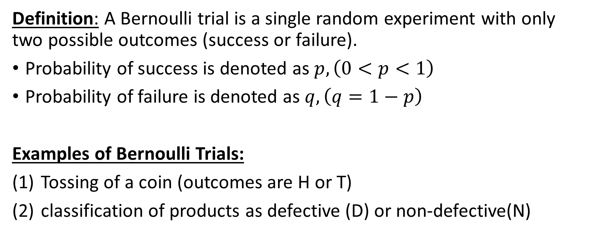
Bernoulli Trials
Definition: A Bernoulli trial is a single random experiment with only two possible outcomes (success or failure).
Probability of success is denoted as $p, \left(0<p<1\right)$
Probability of failure is denoted as $q, \left(q=1−p\right)$
Examples of Bernoulli Trials:
Tossing of a coin (outcomes are H or T)
classification of products as defective (D) or non-defective(N)

Slide 21
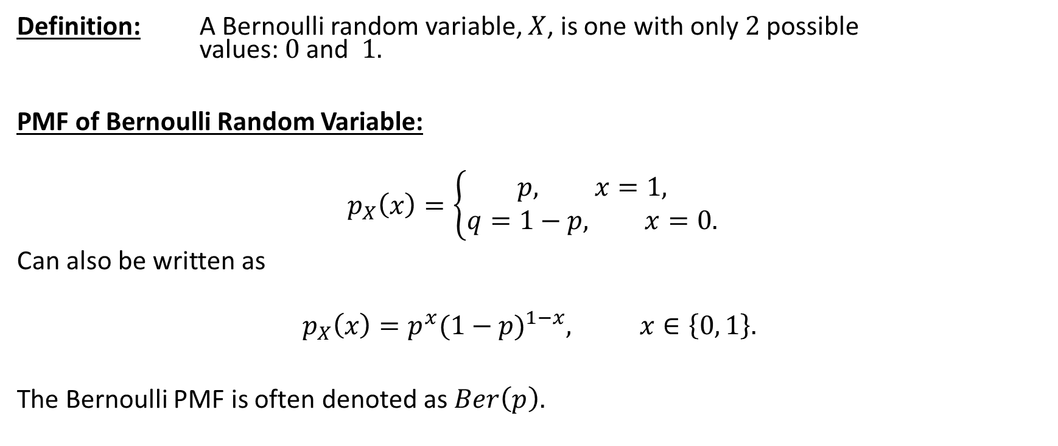
Bernoulli Random Variables
Definition: A Bernoulli random variable, $X$, is one with only $2$possible values: $0$ and $1.$
PMF of Bernoulli Random Variable:
$$p_{X}\left(x\right)=\left\{\begin{aligned}p, x=1, \\ &q=1−p, x=0.\end{aligned}\right.$$
Can also be written as
$$p_{X}\left(x\right)=p^{x}{(1−p)}^{1−x}, x∈\left\{0, 1\right\}.$$
The Bernoulli PMF is often denoted as $Ber\left(p\right).$

Slide 22
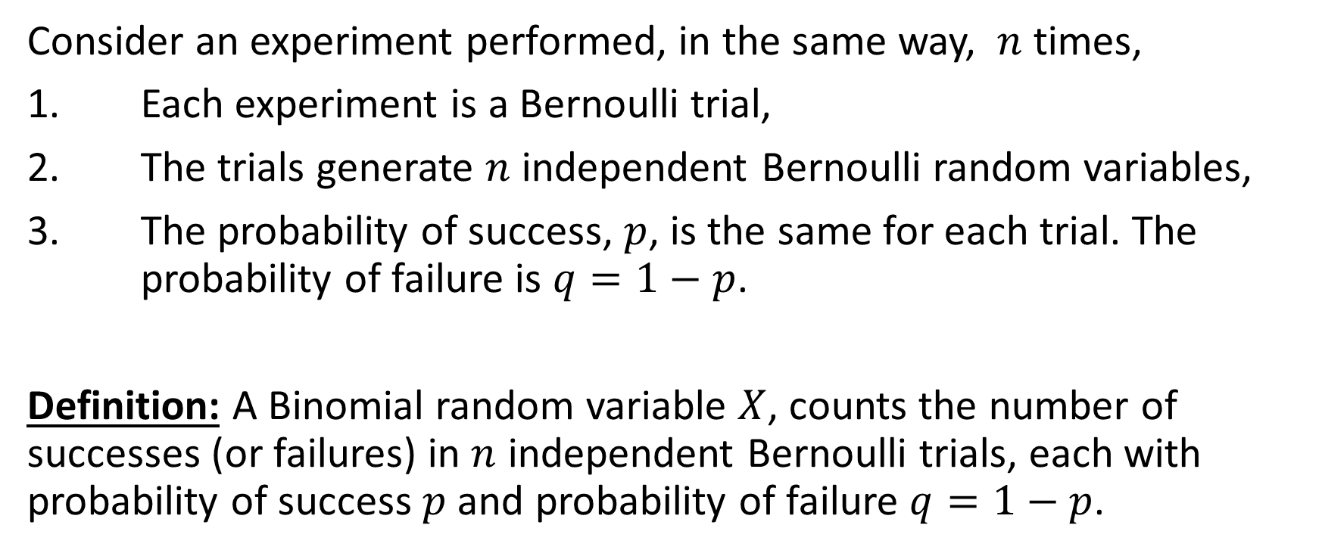
Binomial Random Variables
Consider an experiment performed, in the same way, $n$ times,
1. Each experiment is a Bernoulli trial,
2. The trials generate $n$ independent Bernoulli random variables,
3. The probability of success, $p$, is the same for each trial. The probability of failure is $q=1−p$.
Definition: A Binomial random variable $X$, counts the number of successes (or failures) in $n$ independent Bernoulli trials, each with probability of success $p$ and probability of failure $q=1−p$.

Slide 23
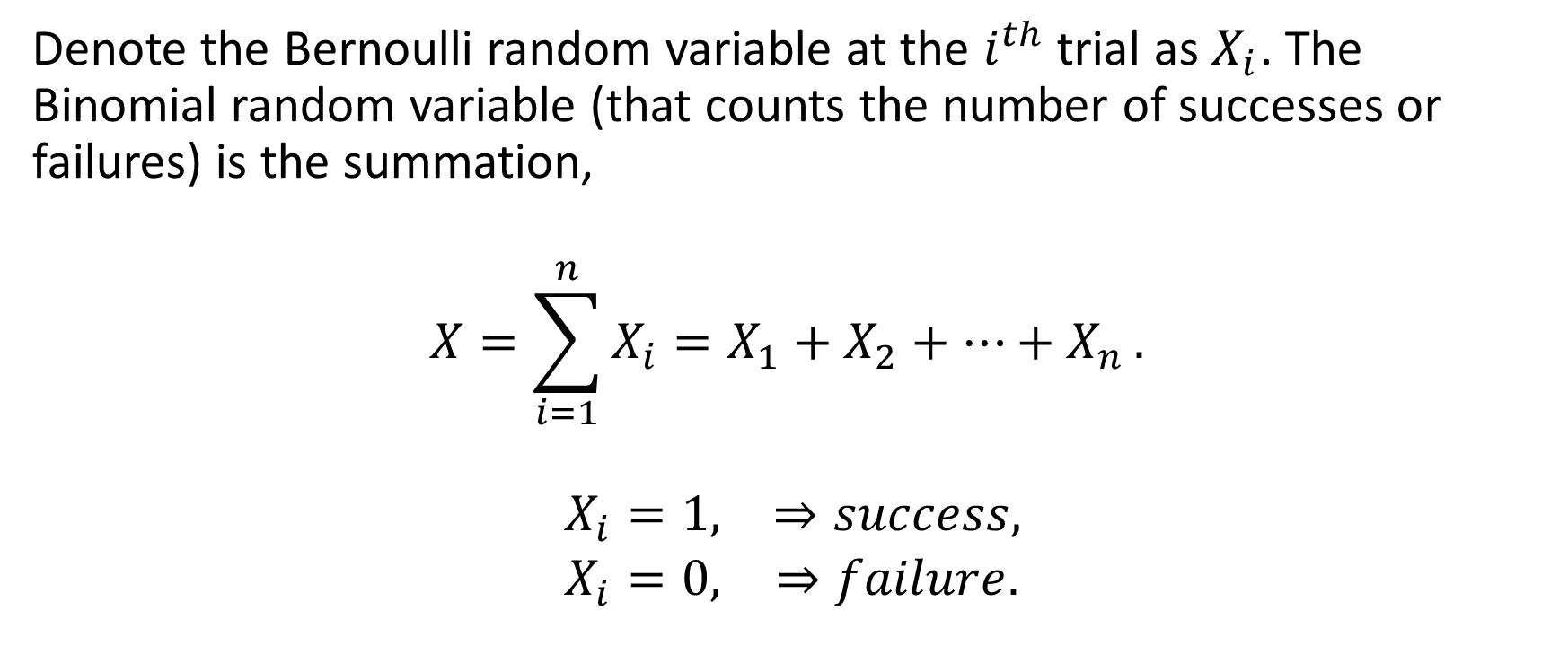
Binomial Random Variables
Denote the Bernoulli random variable at the $i^{th}$ trial as $X_{i}$. The Binomial random variable (that counts the number of successes or failures) is the summation,
$$X=\sum_{i=1}^{n}{X_{i}=X_{1}+X_{2}+…+X_{n}}.$$
$$\begin{matrix}X_{i}=1, & ⇒success, \\ X_{i}=0, & ⇒failure.\end{matrix}$$

Slide 24
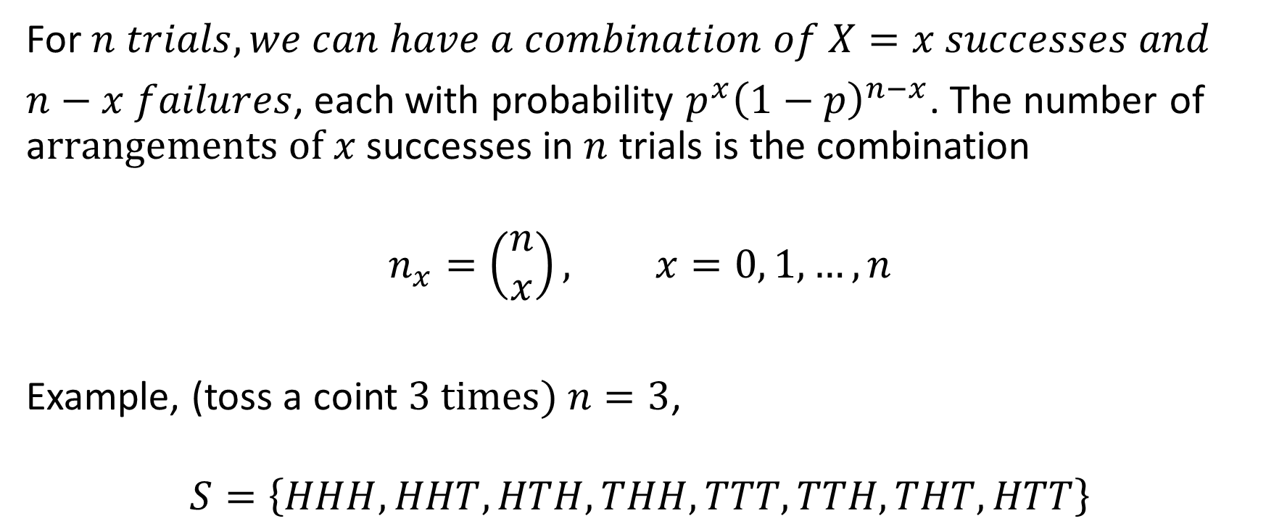
PMF of Binomial Random Variables
For $n trials, we can have a combination of X=x successes and$
$n−x failures$, each with probability $p^{x}{\left(1−p\right)}^{n−x}$. The number of a$rrangements of x$ successes in $n$ trials is the combination
$$n_{x}=\left(\begin{aligned}n \\ x\end{aligned}\right), x=0, 1, …, n$$
Example, (toss a coint $3 times) n=3$,
$$S=\left\{HHH, HHT, HTH, THH, TTT, TTH, THT, HTT\right\}$$

Slide 25
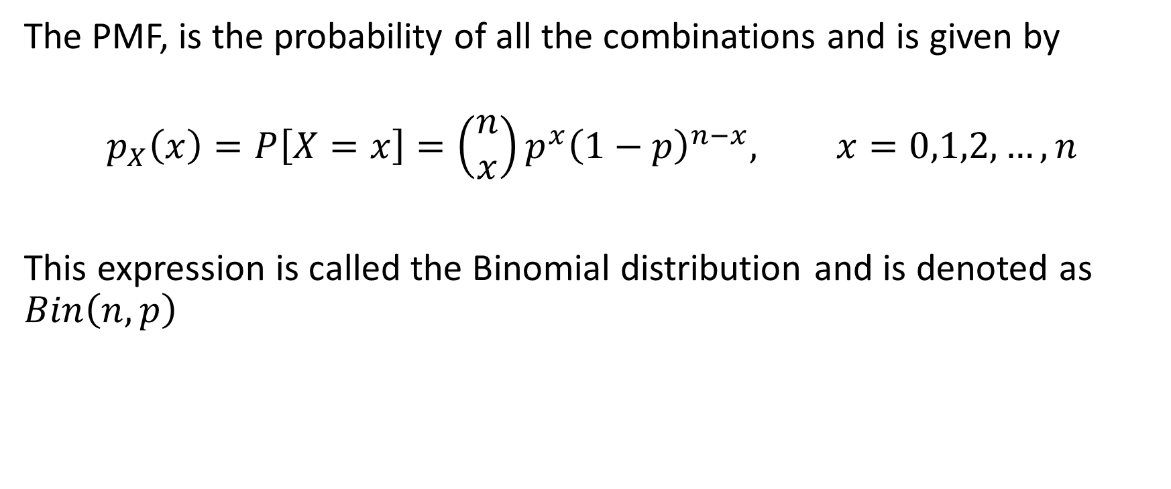
PMF of Binomial Random Variables
The PMF, is the probability of all the combinations and is given by
$$p_{X}\left(x\right)=P\left[X=x\right]=\left(\begin{aligned}n \\ x\end{aligned}\right)p^{x}{\left(1−p\right)}^{n−x}, x=0,1,2,…,n$$
This expression is called the Binomial distribution and is denoted as $Bin\left(n,p\right)$

Slide 26

Binomial Random Variable Example 5
A manufacturing process results in probability $p=0.05$ of generating defective products. Suppose we select $3$ products, in succession, from the manufacturing process and inspect them. What are the probabilities for the different numbers of defective products?

Slide 27
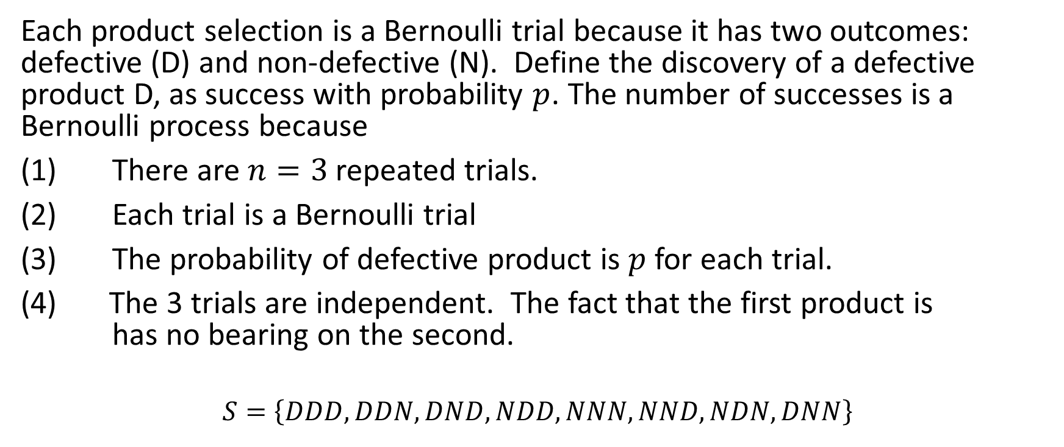
Example 5 Solution
Each product selection is a Bernoulli trial because it has two outcomes: defective (D) and non-defective (N). Define the discovery of a defective product D, as success with probability $p$. The number of successes is a Bernoulli process because
(1) There are $n=3$ repeated trials.
(2) Each trial is a Bernoulli trial
(3) The probability of defective product is $p$ for each trial.
The 3 trials are independent. The fact that the first product is has no bearing on the second.
$$S=\left\{DDD, DDN, DND, NDD, NNN, NND, NDN, DNN\right\}$$

Slide 28
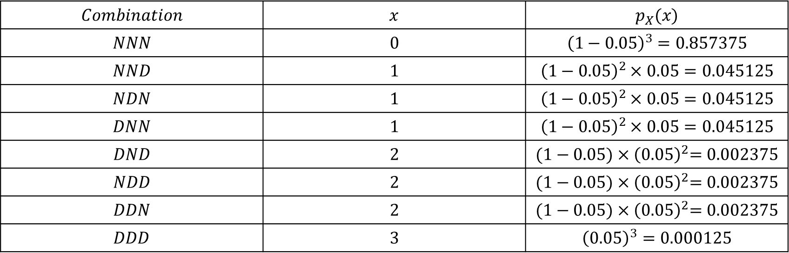

Example 5 continued
Compute the probability for each combination
$$p_{X}\left(x\right)=\left(\begin{aligned}3 \\ x\end{aligned}\right)p^{x}{\left(1−p\right)}^{n−x}, x=0, 1, 2, 3$$
$$Combination$$ | $$x$$ | $$p_{X}(x)$$
$$NNN$$ | $$0$$ | $${\left(1−0.05\right)}^{3}=0.857375$$
$$NND$$ | $$1$$ | $${\left(1−0.05\right)}^{2}×0.05=0.045125$$
$$NDN$$ | $$1$$ | $${\left(1−0.05\right)}^{2}×0.05=0.045125$$
$$DNN$$ | $$1$$ | $${\left(1−0.05\right)}^{2}×0.05=0.045125$$
$$DND$$ | $$2$$ | $${(1−0.05)×\left(0.05\right)}^{2}=0.002375$$
$$NDD$$ | $$2$$ | $${(1−0.05)×\left(0.05\right)}^{2}=0.002375$$
$$DDN$$ | $$2$$ | $${(1−0.05)×\left(0.05\right)}^{2}=0.002375$$
$$DDD$$ | $$3$$ | $${\left(0.05\right)}^{3}=0.000125$$

Slide 29


Example 5 continued
Apply formula:
Check:
$$\sum_{x=0}^{3}{p_{X}(x)}=0.857375+0.135375+0.007125+0.000125=1$$
$$p_{X}\left(x\right)=P\left[X=x\right]=\left(\begin{matrix}n \\ x\end{matrix}\right)p^{x}{\left(1−p\right)}^{n−x}, x=0, 1,\text{ 2, 3}$$
$$\begin{matrix}p_{X}\left(0\right)=\left(\begin{matrix}3 \\ 0\end{matrix}\right)p^{0}{\left(1−p\right)}^{3−0}={\left(1−0.05\right)}^{3} \\ p_{X}\left(1\right)=\left(\begin{matrix}3 \\ 1\end{matrix}\right)p^{1}{\left(1−p\right)}^{3−1}=3{\left(1−0.05\right)}^{2}×0.05 \\ p_{X}\left(2\right)=\left(\begin{matrix}3 \\ 2\end{matrix}\right)p^{2}{\left(1−p\right)}^{3−2}=3\left(1−0.05\right)×{0.05}^{2} \\ p_{X}\left(3\right)=\left(\begin{matrix}3 \\ 3\end{matrix}\right)p^{3}{\left(1−p\right)}^{3−3}={0.05}^{3}\end{matrix}$$

Slide 30
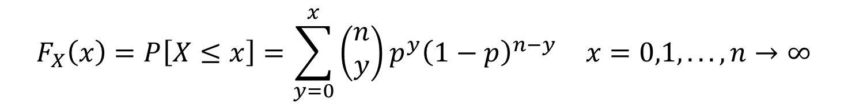
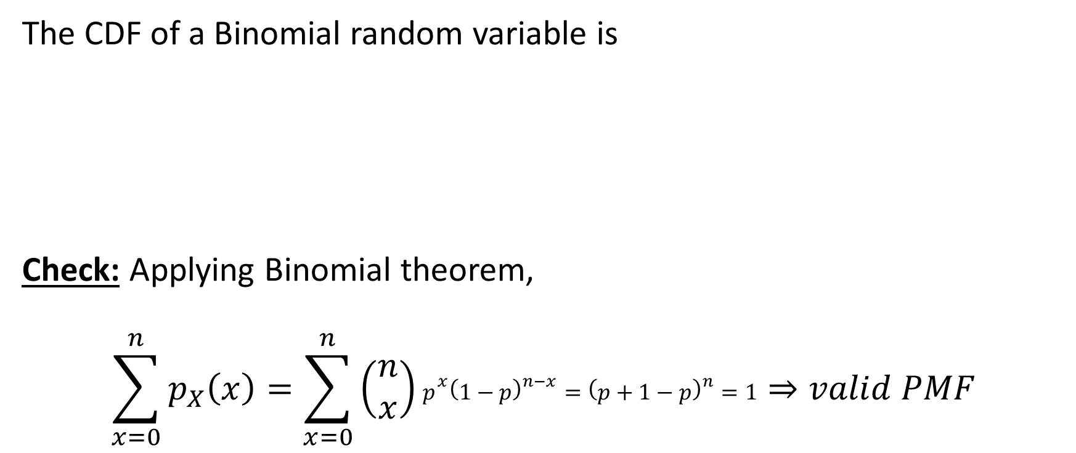
CDF of a Binomial Random Variables
The CDF of a Binomial random variable is
Check: Applying Binomial theorem,
$$\sum_{x=0}^{n}{p_{X}\left(x\right)=\sum_{x=0}^{n}{\left(\begin{matrix}n \\ x\end{matrix}\right)p^{x}{\left(1−p\right)}^{n−x}={\left(p+1−p\right)}^{n}=1}}⇒valid PMF$$
$$F_{X}\left(x\right)=P\left[X≤x\right]=\sum_{y=0}^{x}{\left(\begin{matrix}n \\ y\end{matrix}\right)p^{y}{\left(1−p\right)}^{n−y} x=0,1,...,n→∞}$$

Slide 31
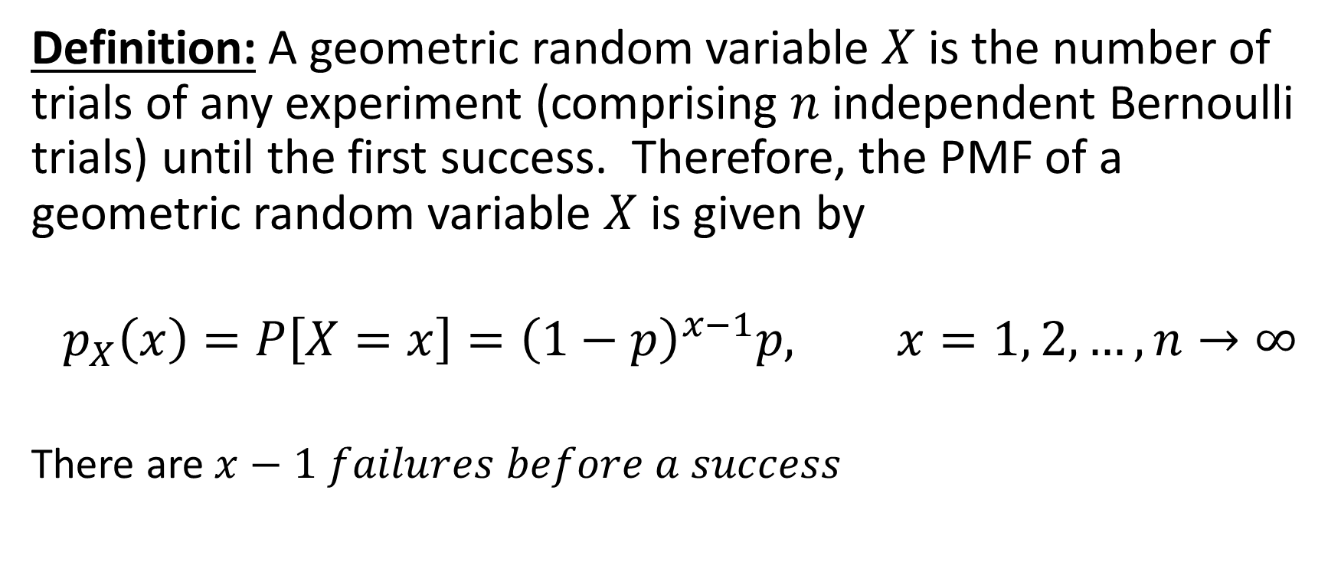
Geometric Random Variables
Definition: A geometric random variable $X$ is the number of trials of any experiment (comprising $n$ independent Bernoulli trials) until the first success. Therefore, the PMF of a geometric random variable $X$ is given by
$$p_{X}\left(x\right)=P\left[X=x\right]={\left(1−p\right)}^{x−1}p, x=1, 2, …,n→∞$$
There are $x−1 failures before a success$

Slide 32
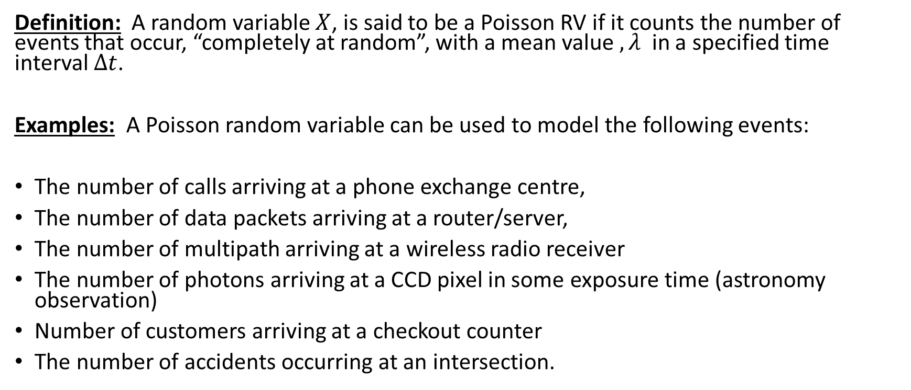
Poisson Random Variables
Definition: A random variable $X$, is said to be a Poisson RV if it counts the number of events that occur, “completely at random”, with a mean value $,λ$ in a specified time interval $Δt$.
Examples: A Poisson random variable can be used to model the following events:
The number of calls arriving at a phone exchange centre,
The number of data packets arriving at a router/server,
The number of multipath arriving at a wireless radio receiver
The number of photons arriving at a CCD pixel in some exposure time (astronomy observation)
Number of customers arriving at a checkout counter
The number of accidents occurring at an intersection.

Slide 33
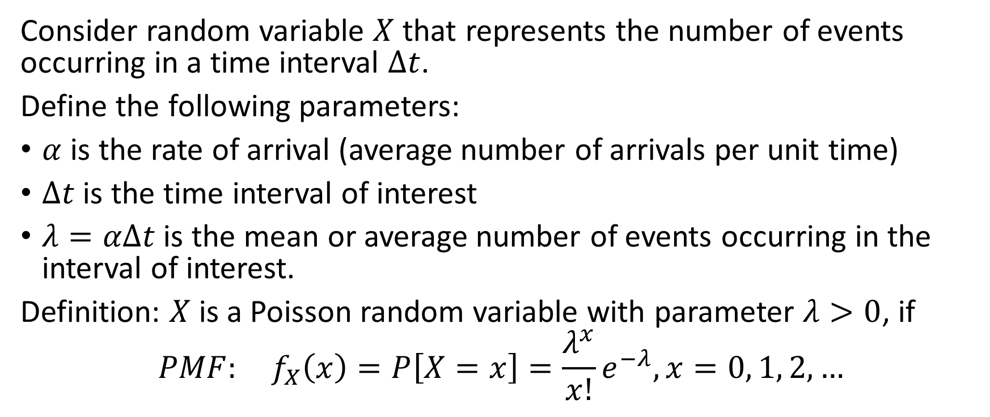
PMF of Poisson RV
Consider random variable $X$ that represents the number of events occurring in a time interval $Δt$.
Define the following parameters:
$α$ is the rate of arrival (average number of arrivals per unit time)
$Δt$ is the time interval of interest
$λ=αΔt$ is the mean or average number of events occurring in the interval of interest.
Definition: $X$ is a Poisson random variable with parameter $λ>0$, if
$$PMF: f_{X}\left(x\right)=P\left[X=x\right]=\frac{λ^{x}}{x!}e^{−λ}, x=0, 1, 2,…$$

Slide 34
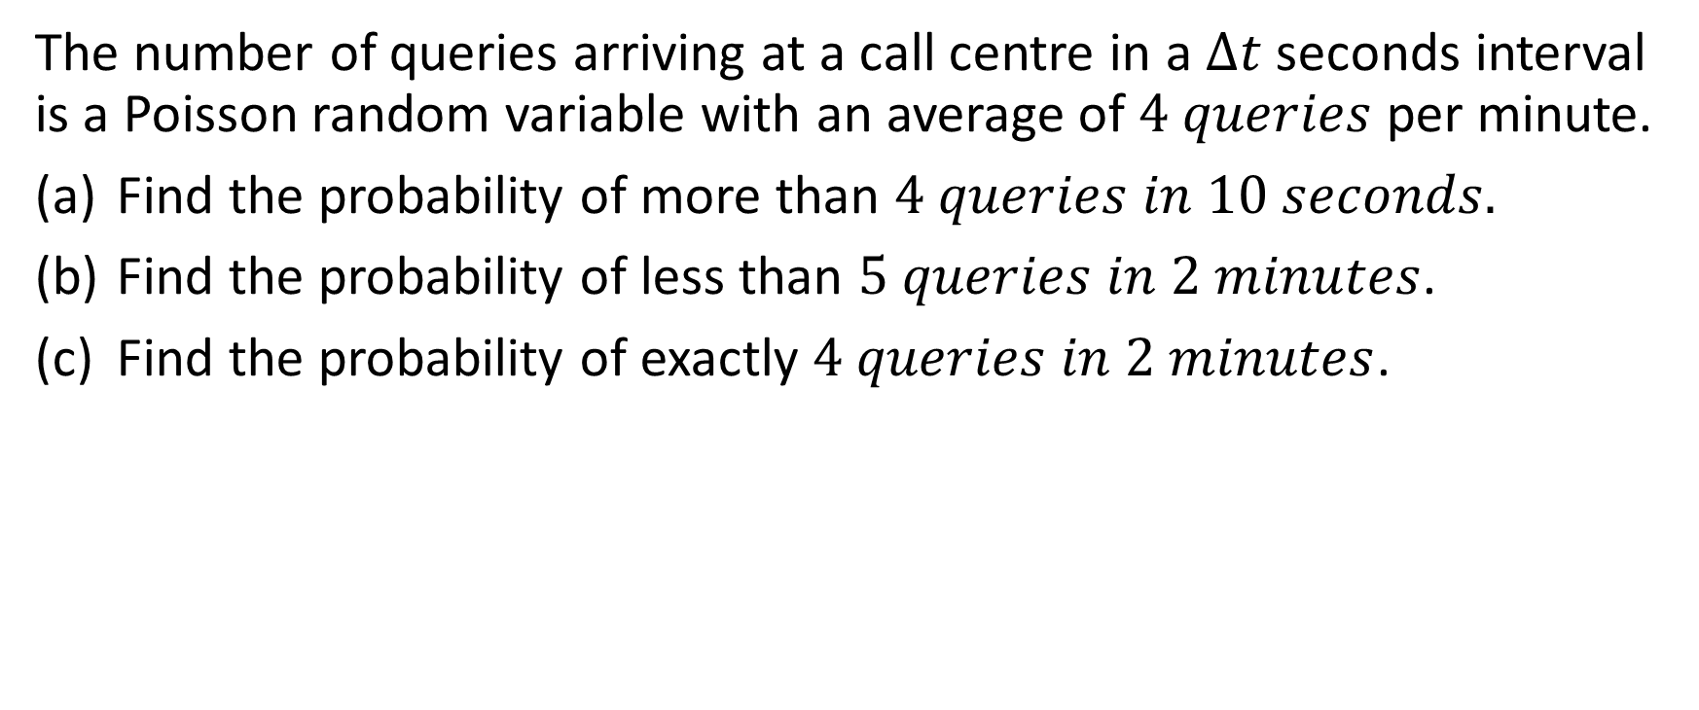
Poisson Random Variables Example
The number of queries arriving at a call centre in a $Δt$ seconds interval is a Poisson random variable with an average of $4 queries$ per minute.
Find the probability of more than $4 queries in 10 seconds.$
Find the probability of less than $5 queries in 2 minutes$.
Find the probability of exactly $4 queries in 2 minutes$.

Slide 35
Poisson Random Variables Example

Slide 36
Poisson Random Variables Example

Slide 37
Uniform Random Variables

Slide 38
Useful Series in Probability

